Slide 1

Airline Ticket Price Prediction
Presented by:
Nour Kamaly
Nourhan AbdelKarim
Abdelrahman Sayed
Mohamed Nour
Ahmed Samy

Slide 2




Presented by
Name
Name
Name
Title
Title
Title
Title

Slide 3
Machine Learning Life Cycle
Data Analysis
It is the process of collecting, modeling, and analyzing data to extract insights that support decision-making. Done by Power BI
Transformation of raw data into useful and efficient format.
Modeling
Training a machine learning algorithm to predict the labels from the features and validating it on holdout data.
Deployment
Integrating a machine learning model into an existing production environment (web application)
Testing the model performance in terms of accuracy/precision of the models on unseen data
Preprocessing
Testing

Slide 4

Data Analysis

Slide 5
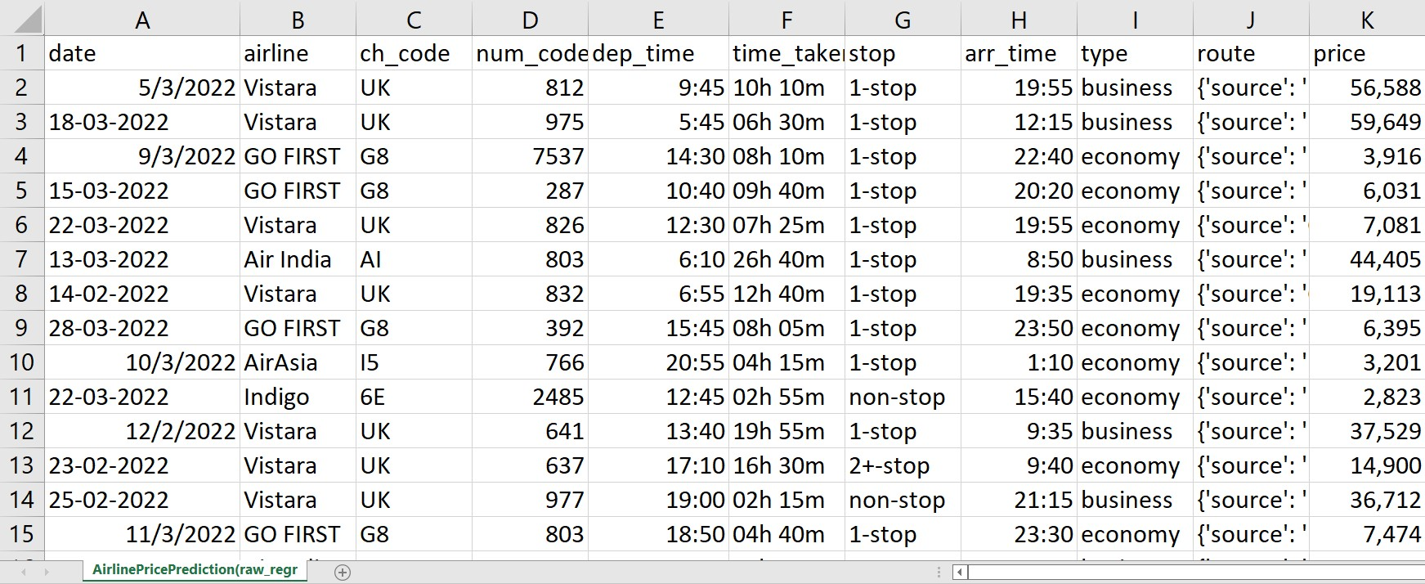
Our data

Slide 6
We gathered 20 questions about the data
what is the airline that has the most expensive ticket (business and economy)?what is the airline that has the c
What is the most airline used?
what is the most expensive 'business type' ticket in each airline and what is its duration and date?
what is the cheapest 'business type' ticket in each airline and what is its duration and date?
what is the most expensive 'economy type' ticket in each airline and what is its duration and date?
what is the cheapest 'economy type' ticket in each airline and what is its duration and date?
how much did the longest flight cost in business and economy types?
What time of the day has the most expensive (business and economy) ticket in each airline?
what is the day-average ticket price (business and economy) in each day of the week?
what is the month-average ticket price (business and economy) in each month of the year?
What is the most departure and arrival time for planes during the day?
Who is the most frequent source which takes off planes from it?
Who is the most frequent destination for planes?
What is the most popular day and month for flight?
How much did the longest flight take?
what is the most number of stops during the flight?
what is the least frequent source for airplanes?
what us the least frequent destination?
What is the busiest duration of the day for flights?
What is the freest duration of the day for flights?

Slide 7
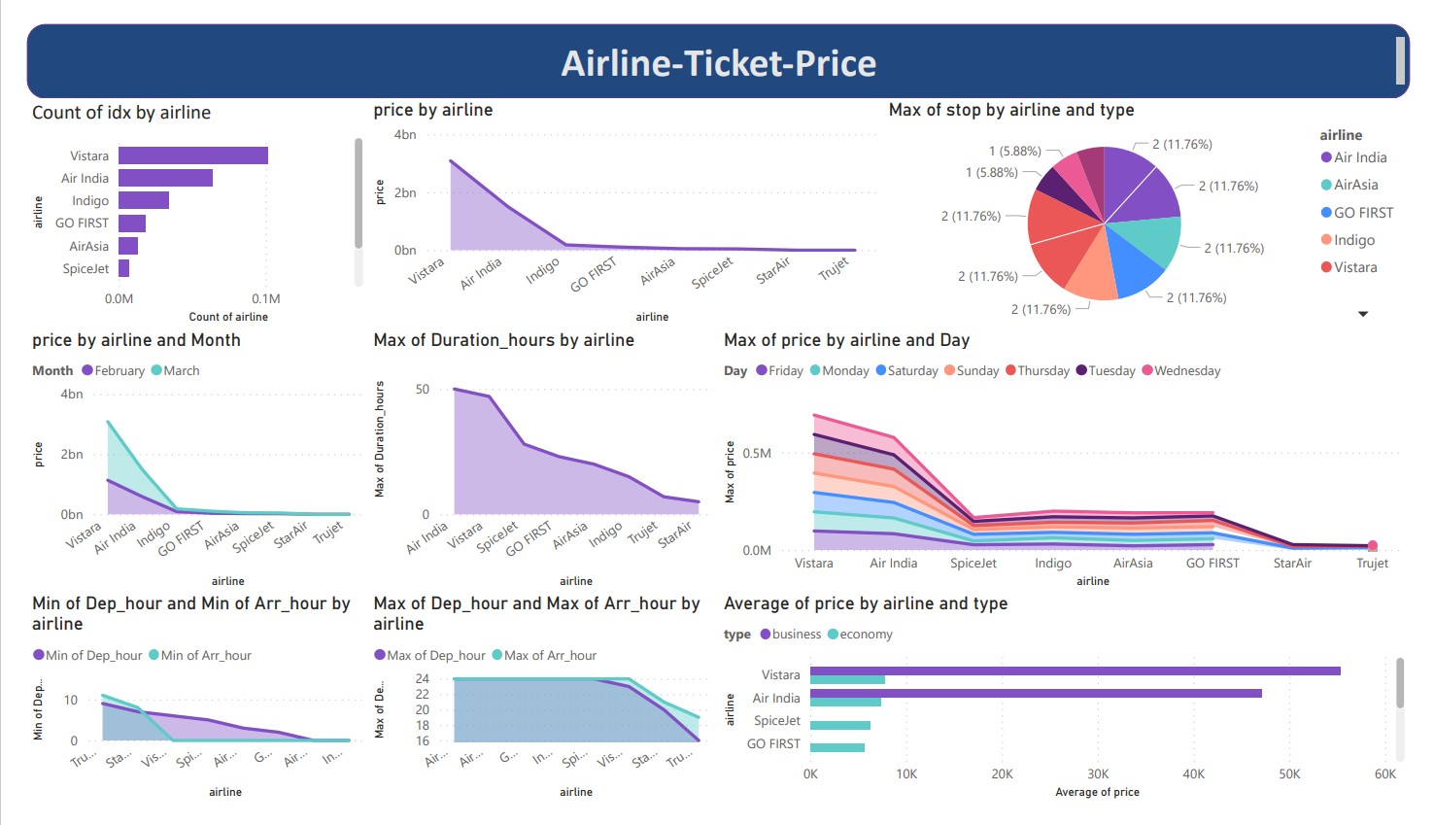

Slide 8
Preprocessing

Slide 9
Time Series Data

Slide 10
Techniques applied
Sorting the data from the oldest to the newest and by the flight hour and minute to avoid data leakage when splitting the data into a training and validation set
Extracting day name of flight, the day and the month from the date
Creating a feature balance between airline categories
Extracting the distance between the source and the destination
Removing the outliers from the price using the interquartile range (statistical method)
Selecting the features using p value (probabilistic method)
Data transformation using the discrete cosine transform

Slide 11
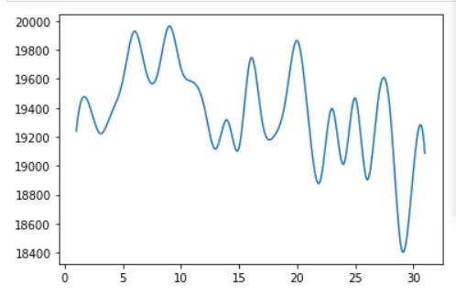
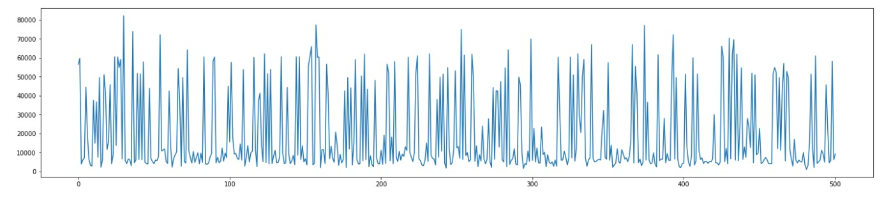
The plot of time and the ticket price

Slide 12
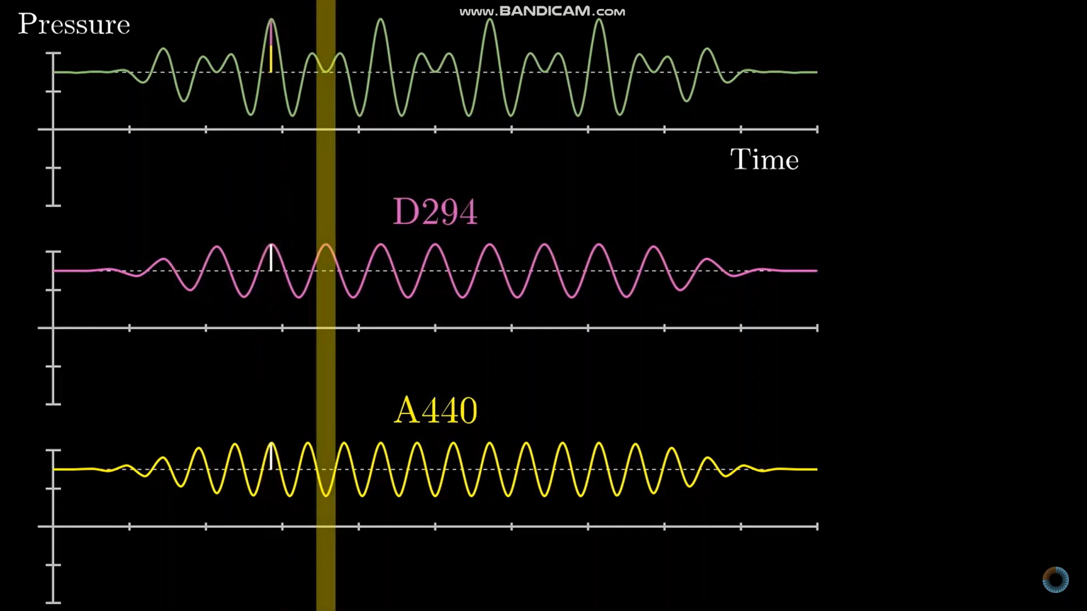
Fourier Transform
Name
Name
Name
Name
Title
Title
Title
Title

Slide 13
Modeling

Slide 14
Models used :
eXtreme Gradient Boosting Regressor 8. Bagging Regressor
Poisson Regressor 9. Decision Tree Regressor
Histogram Gradient Boosting Regressor 10. Random Forest
Linear Regression 11. Bagging Ensemble Learner
Light Gradient Boosting Machine Regressor
Gradient Boosting Regressor
Extra Tree Regressor

Slide 15
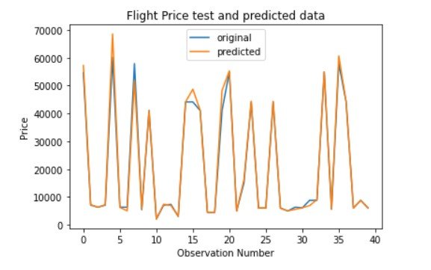
Models
Random Forest Model
Model | Training Score | Testing Score
Random Forest | 0.9799 | 0.9803
Bagging Regressor | 0.9791 | 0.9797
Extra Tree Regressor | 0.9805 | 0.9799
Decision Tree | 0.9805 | 0.9781

Slide 16
Deployment

Slide 17
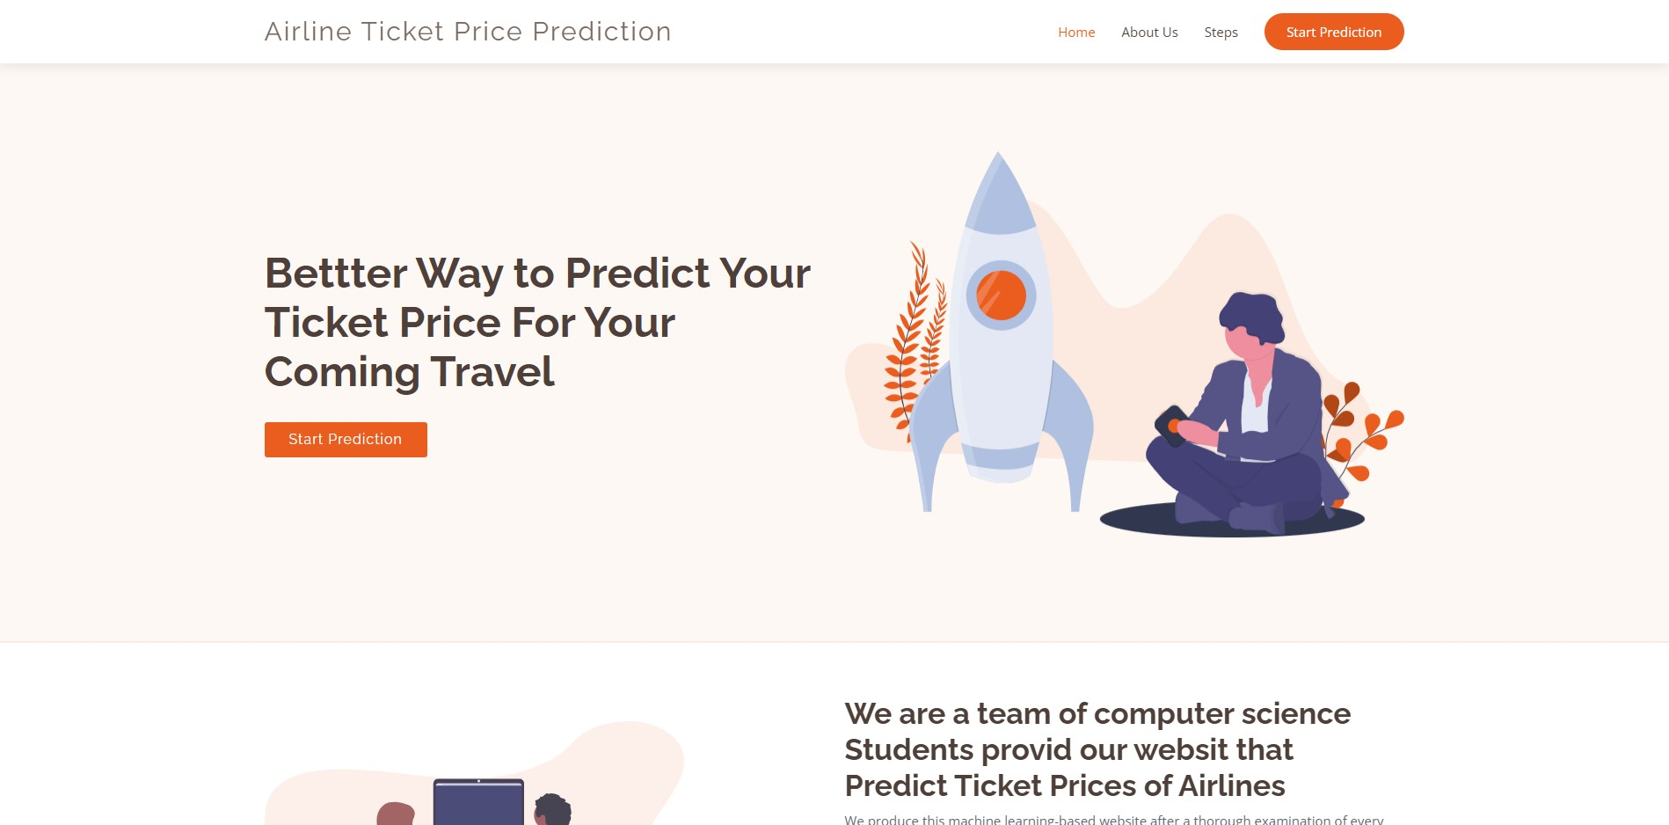
Our Web Application

Slide 18
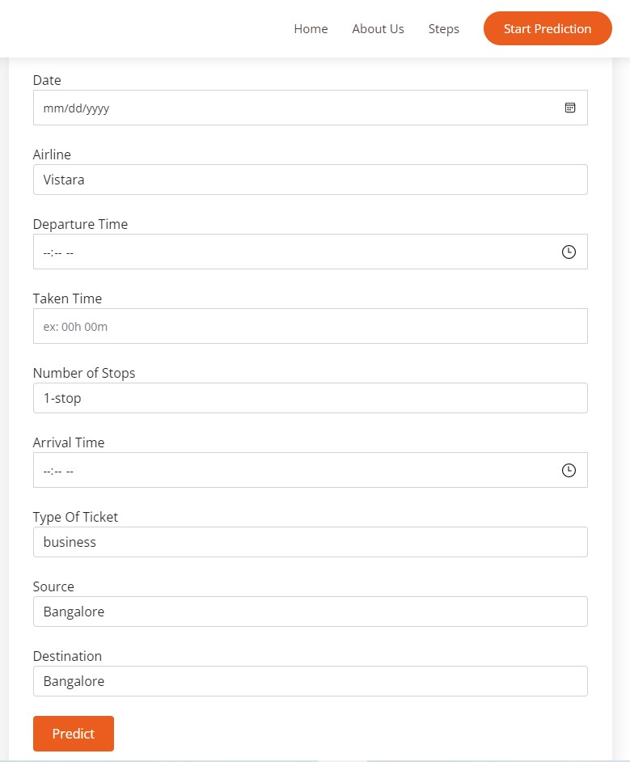

Slide 19
Conclusion
1. Time was the most important factor in the project, just the presence of the date feature directed us in how the dataset should be sorted, the features we could extract from it, how to split it to a training and a validation set and which models we shouldn't use with it.
2. The project can be found here.

Slide 20
References
Analysis
Preprocessing
Modeling
Power BI
DataCamp Introduction to Power BI
- (1) Guy in a Cube - YouTube
P value
- (1) StatQuest: P Values, clearly explained – YouTube
- What is P-Value? - Understanding the meaning, math and methods | Machine Learning Plus
Class Imbalance
- (1) Machine Learning Classification How to Deal with Imbalanced Data ❌ Practical ML Project with Python - YouTube
- Imbalanced Classification | Handling Imbalanced Data using Python (analyticsvidhya.com)
XGB Regressor
- DataTechNotes: Regression Example with XGBRegressor in Python
Random Forest Regressor
- sklearn.ensemble.RandomForestRegressor — scikit-learn 1.1.1 documentation
Poisson Regressor
- sklearn.linear_model.PoissonRegressor — scikit-learn 1.1.1 documentation

Slide 21



Questions ?

Slide 22


Thank You

